Slide 2
B
C
A
D

Slide 6


Slide 8
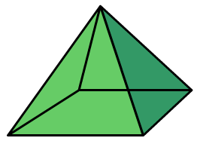

Slide 9
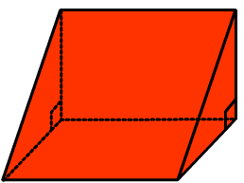
A
B
C
D

Slide 10
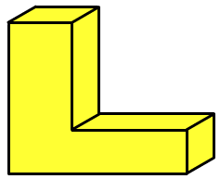
A
F
E
D
B
C

