Slide 1
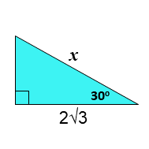


$$\frac{π}{6}$$

Slide 2
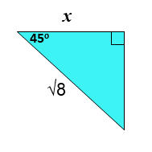


$$\frac{π}{4}$$

Slide 3
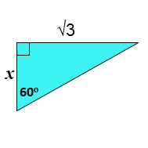


$$\frac{π}{3}$$

Slide 4
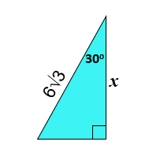


$$\frac{π}{6}$$

Slide 5
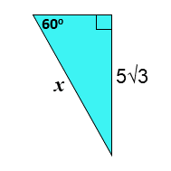


$$\frac{π}{3}$$

Slide 6
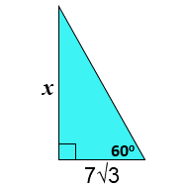


$$\frac{π}{3}$$

Slide 7
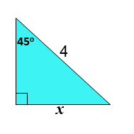


$$\frac{π}{4}$$

Slide 8
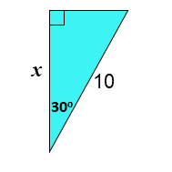


$$\frac{π}{6}$$

Slide 9
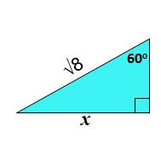

$$\frac{π}{4}$$

Slide 10
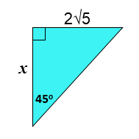
$$\frac{π}{4}$$

Slide 11
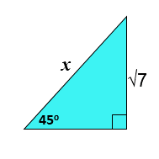


$$\frac{π}{4}$$

Slide 12
